Slide 1
Deep Learning with Tensorflow
Seth Juarez
@sethjuarez

Slide 2
artificial intelligence
machine learning
deep learning

Slide 3

programming
algorithm
answers
input

Slide 4
machine learning
answers
algorithm
input

Slide 5

machine learning
model
data
Tensorflow

Slide 6

machine learning
data
Tensorflow
model / algorithm
code
answers
input

Slide 7


Slide 8
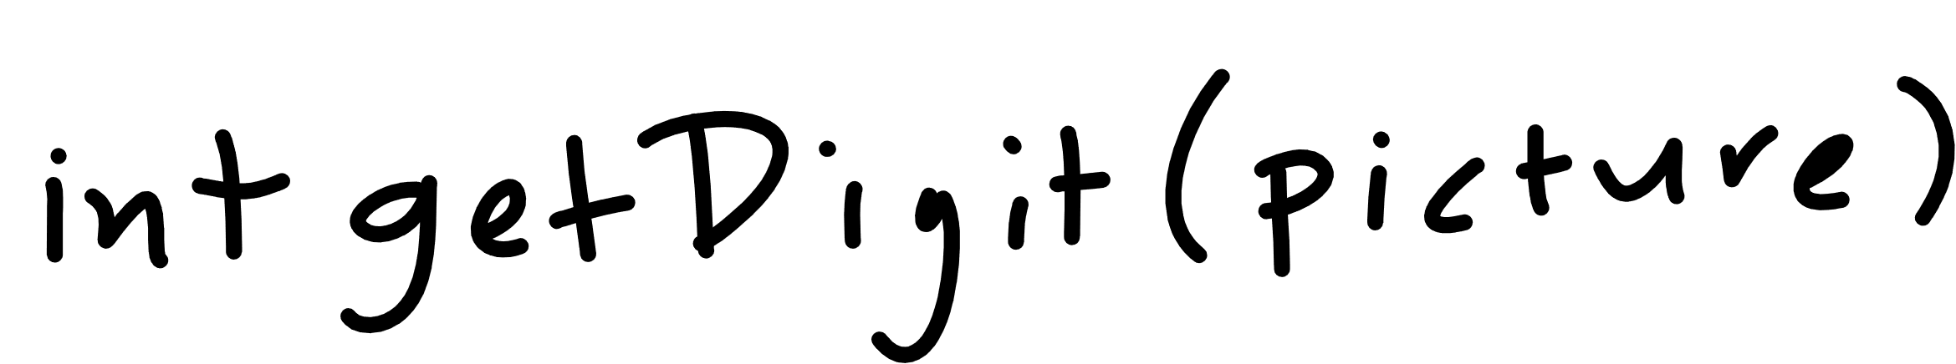

Slide 9

Notes:
Cover the fact that ML uses data to make its own functions

Slide 10
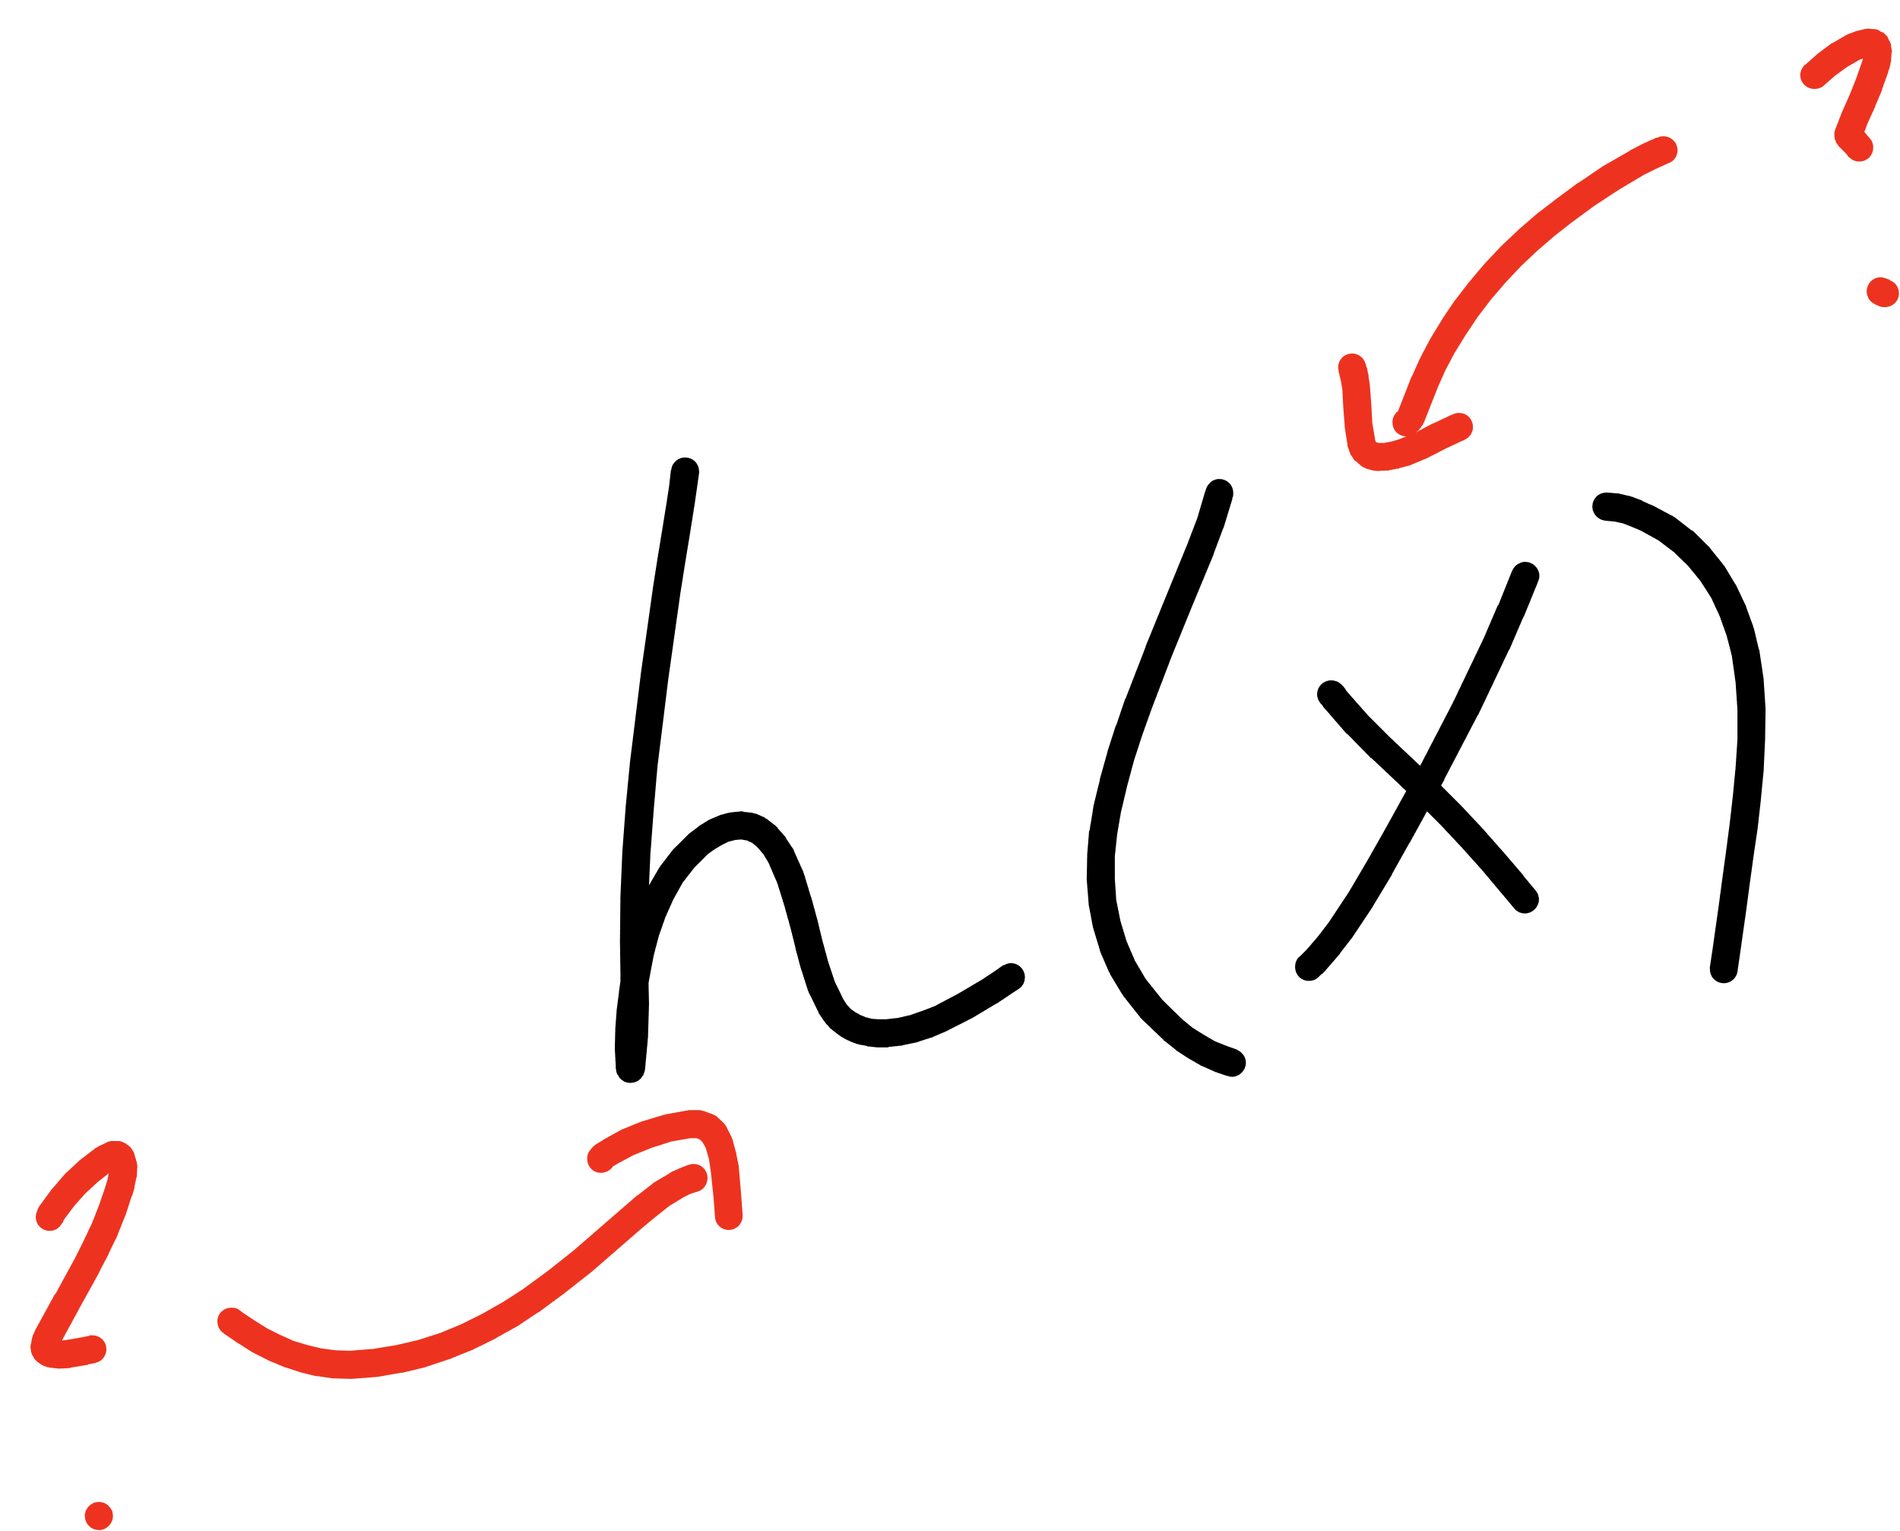
Notes:
Open mnist data representation

Slide 11
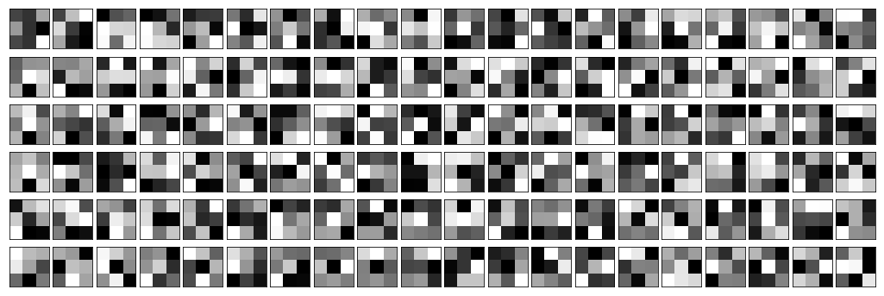
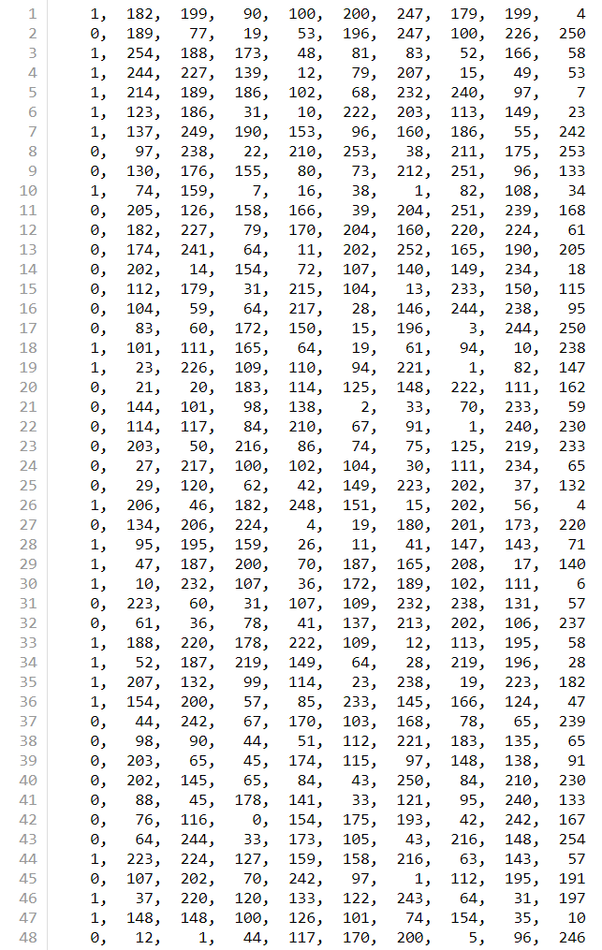


Slide 12
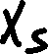
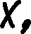
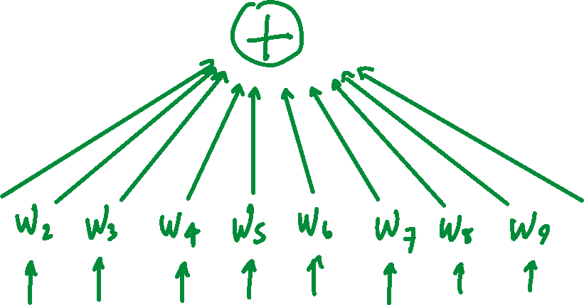
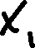

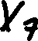

Slide 13
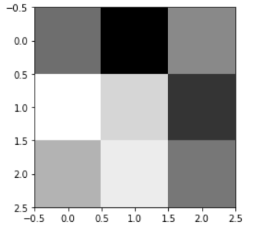
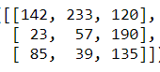
[142, 233, 120, 23, 57, 190, 85, 39, 135]

Slide 14
[ 1, 1, 1, 0, 0, 0, -1, -1, -1]
[142, 233, 120, 23, 57, 190, 85, 39, 135]
236

Slide 15
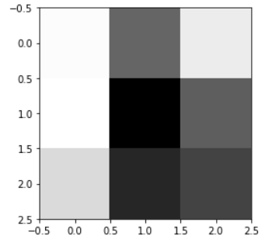
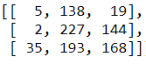
[5, 138, 19, 2, 227, 144, 35, 193, 168]

Slide 16
[ 1, 1, 1, 0, 0, 0, -1, -1, -1]
[5, 138, 19, 2, 227, 144, 35, 193, 168]
-234

Slide 17
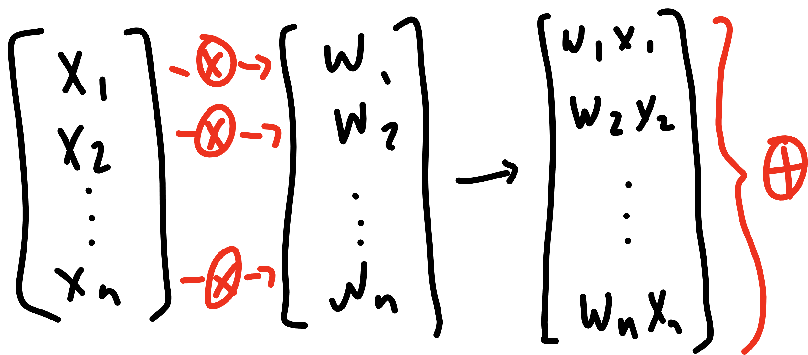

Slide 18
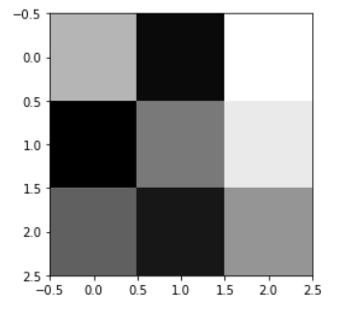








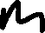
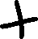

Slide 19






Slide 20












Slide 21










Slide 22

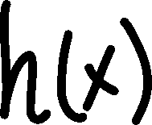







Slide 23











Slide 24
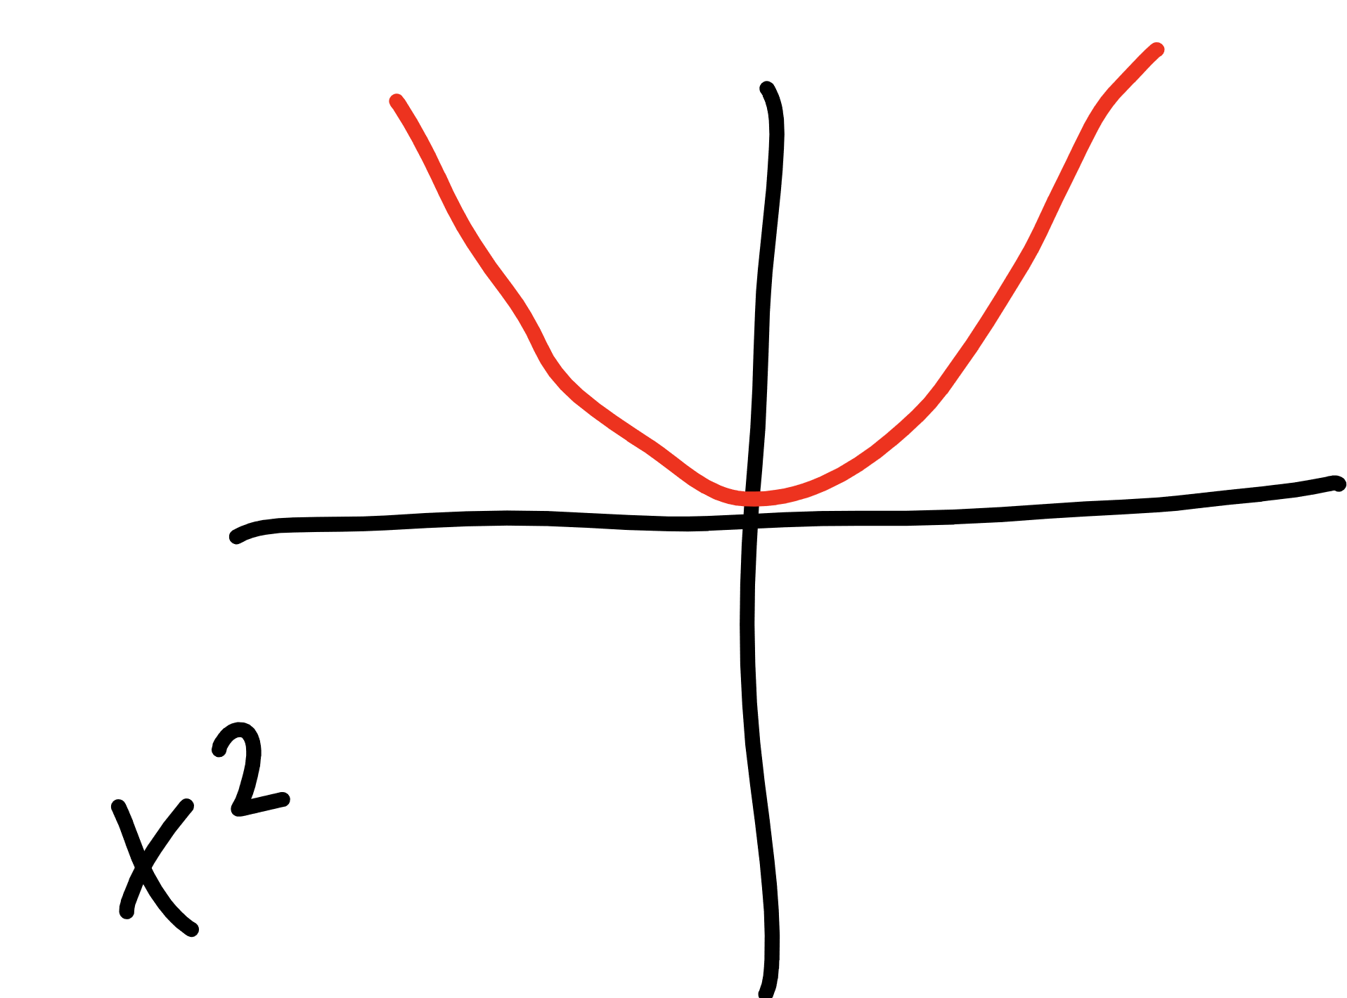

Slide 25
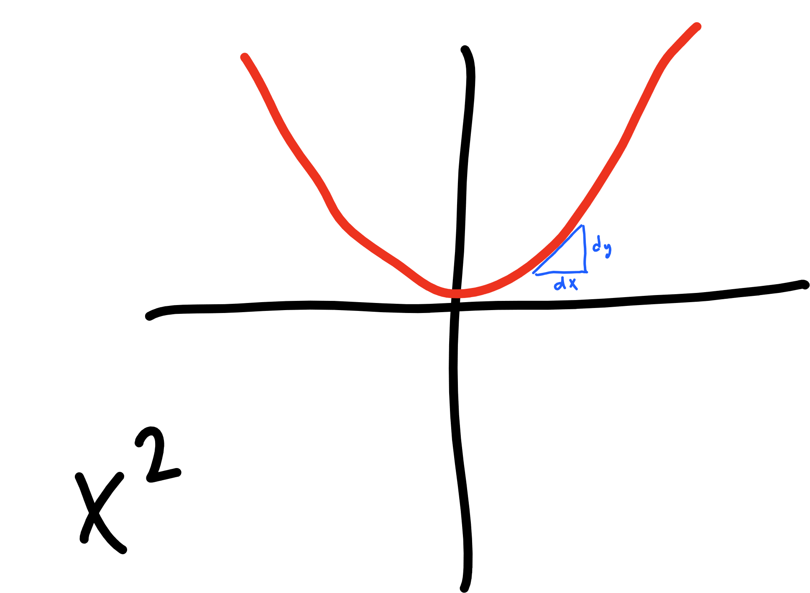

Slide 26
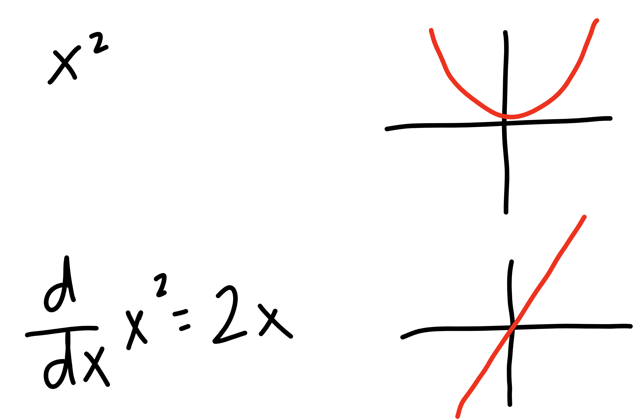


Slide 27







learning
rate
updated W
derivative of
cost function
current W

Slide 28

learning
rate
gradient of
cost function
updated W
current W

Slide 29








learning
rate
gradient of
cost function
updated W
current W

Slide 30


learning
rate
gradient of
cost function
updated b
current b

Slide 31



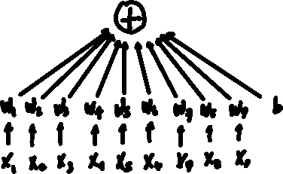

top
middle
bottom

Slide 32
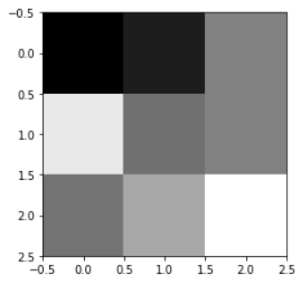
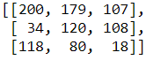




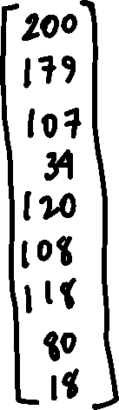


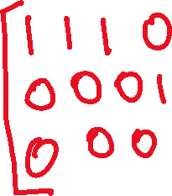
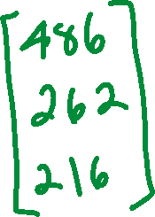

Slide 33






Slide 34
Tensorflow
a primer for devs

Slide 35
PyTorch Overview
Data
Tensors
Variables
Datasets
Models
Model Function
Loss
Optimization
Inference
Saving / Loading Models

Slide 36
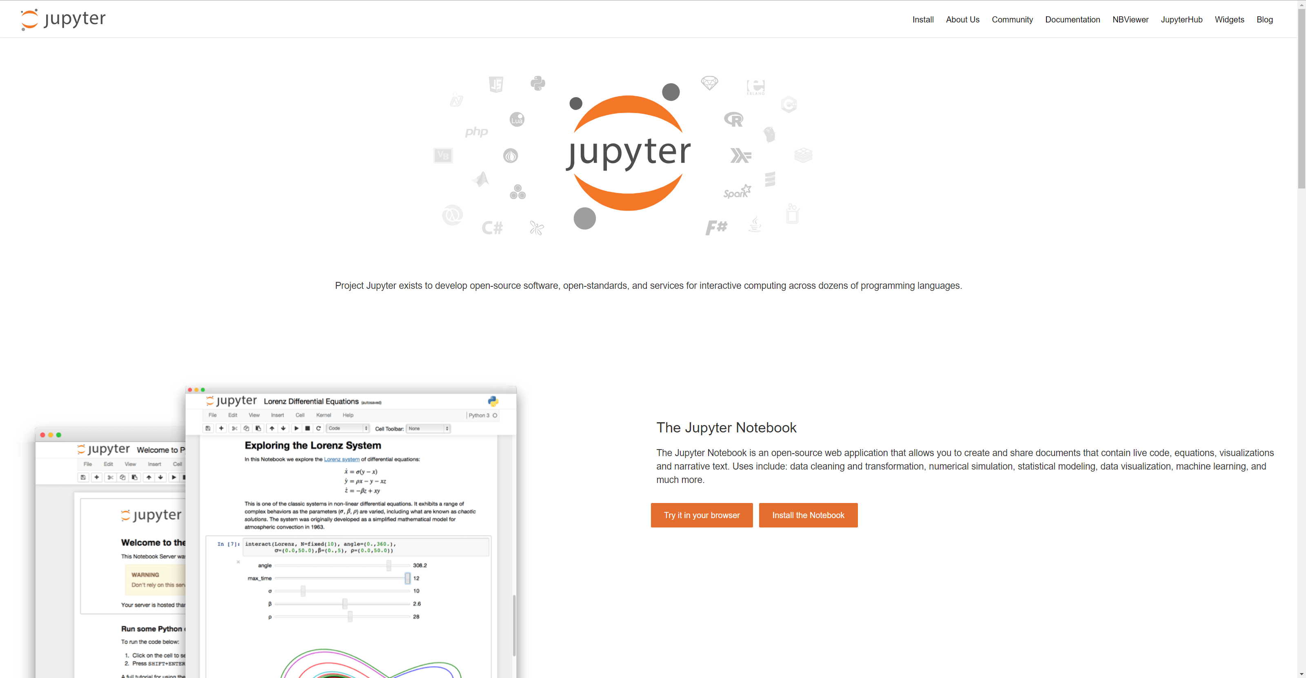

Slide 37
Tensors and Variables

Slide 38
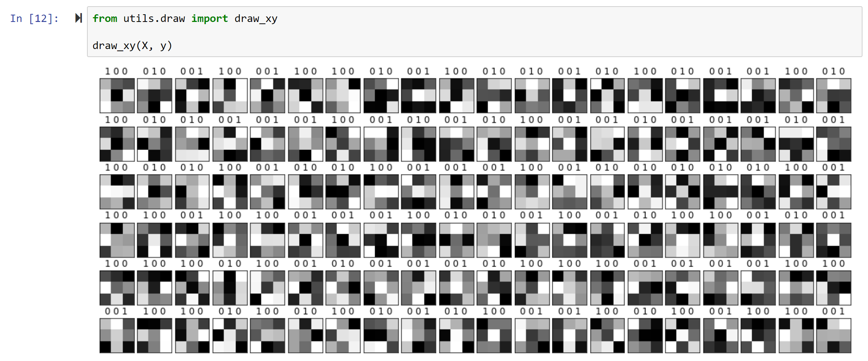

Slide 39
Tensors
PyTorch Tensors are special

Slide 40
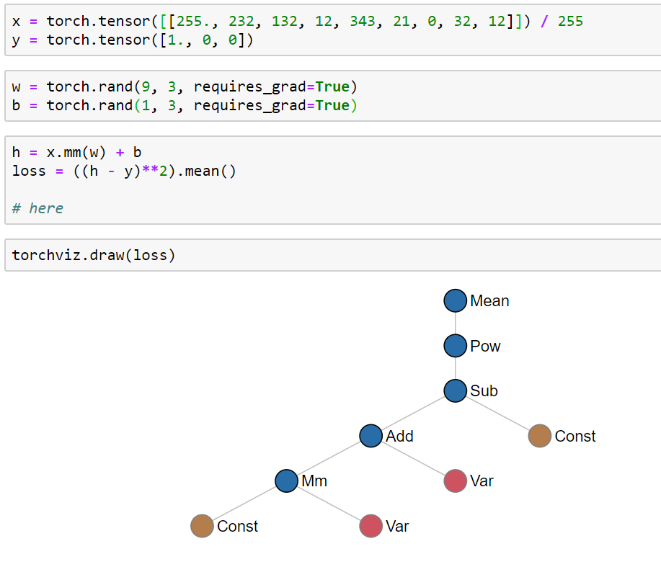

Slide 41
DataSets and DataLoaders

Slide 42
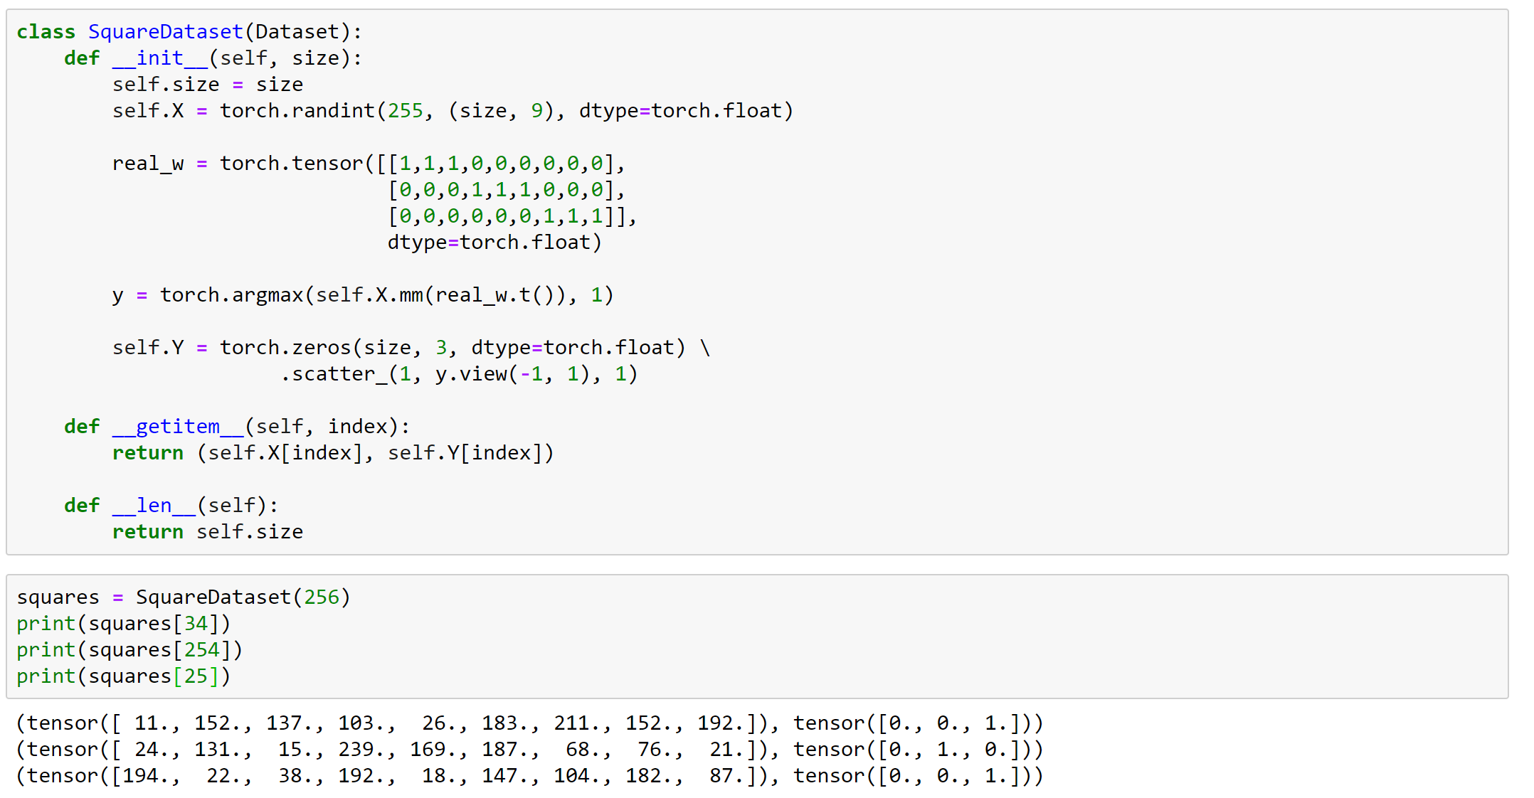

Slide 43
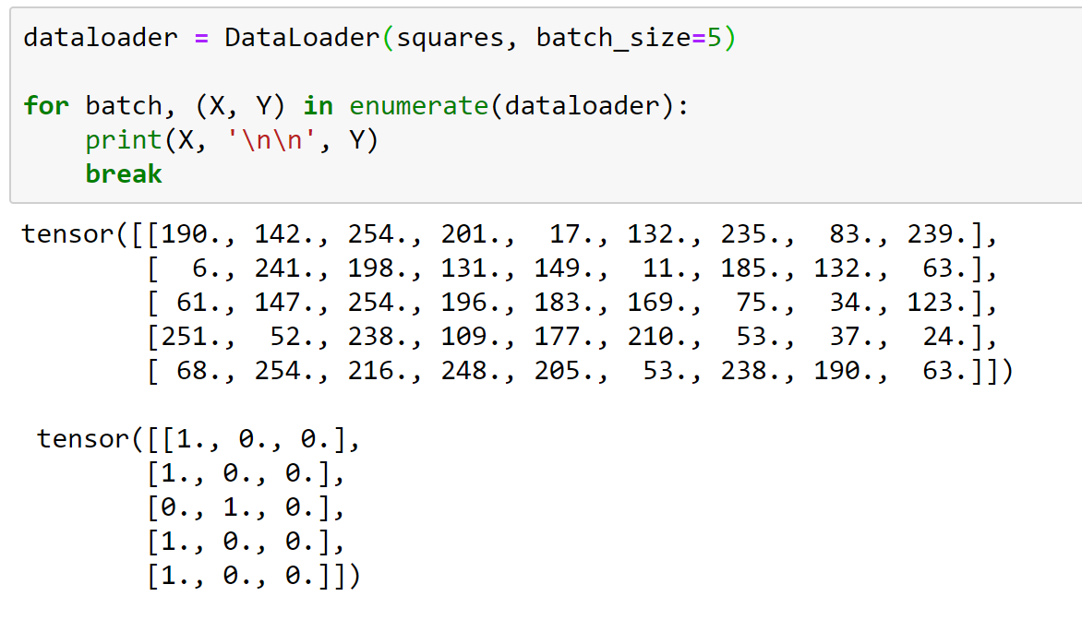

Slide 44
Models and Loss (…or Cost)

Slide 45
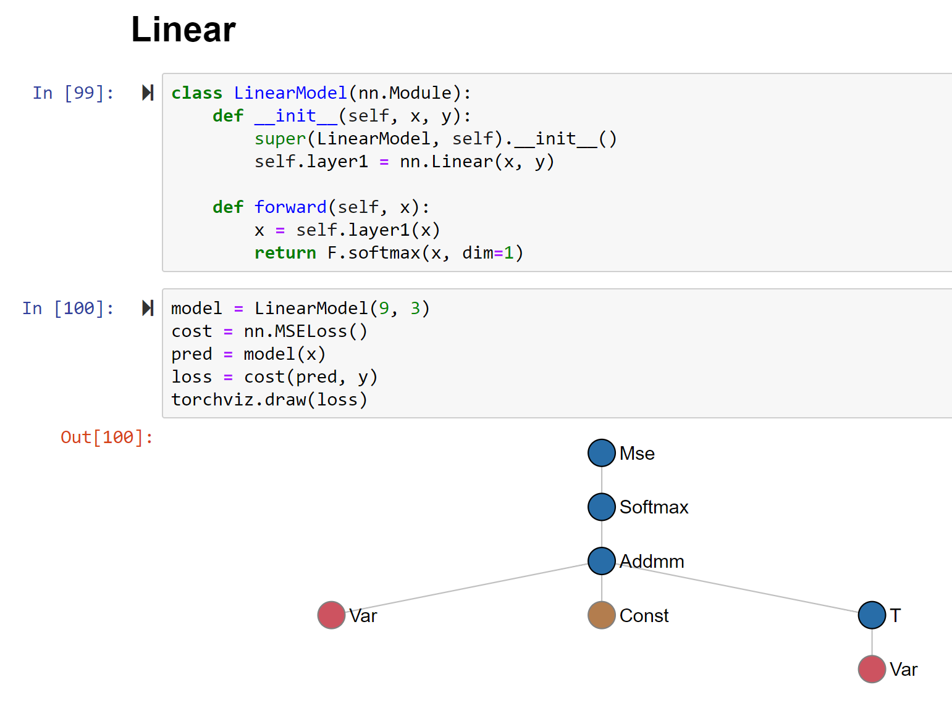

Slide 46
Optimization
The Loop!

Slide 47
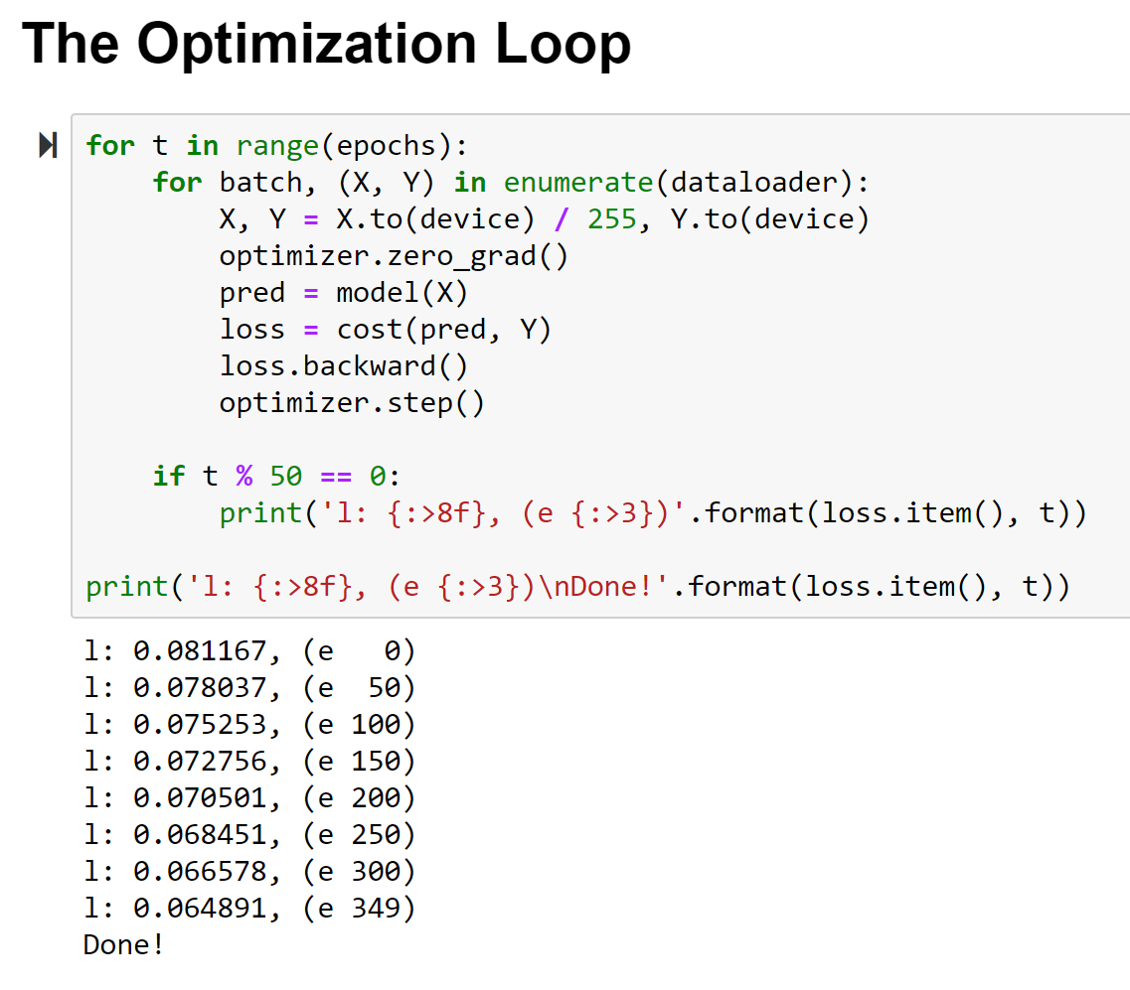

Slide 48
Inference
Using the model…

Slide 49
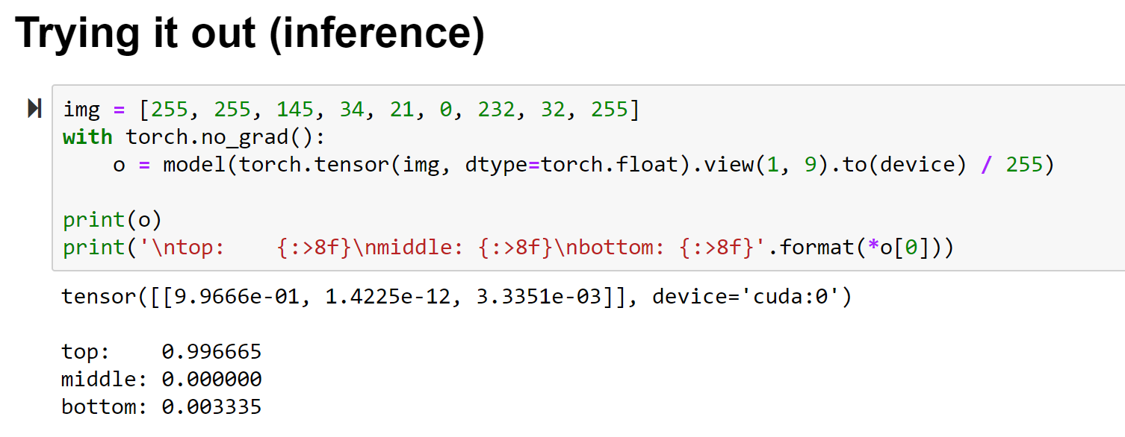

Slide 50


Slide 51


Slide 52
Digits tho…

Slide 54






Slide 55
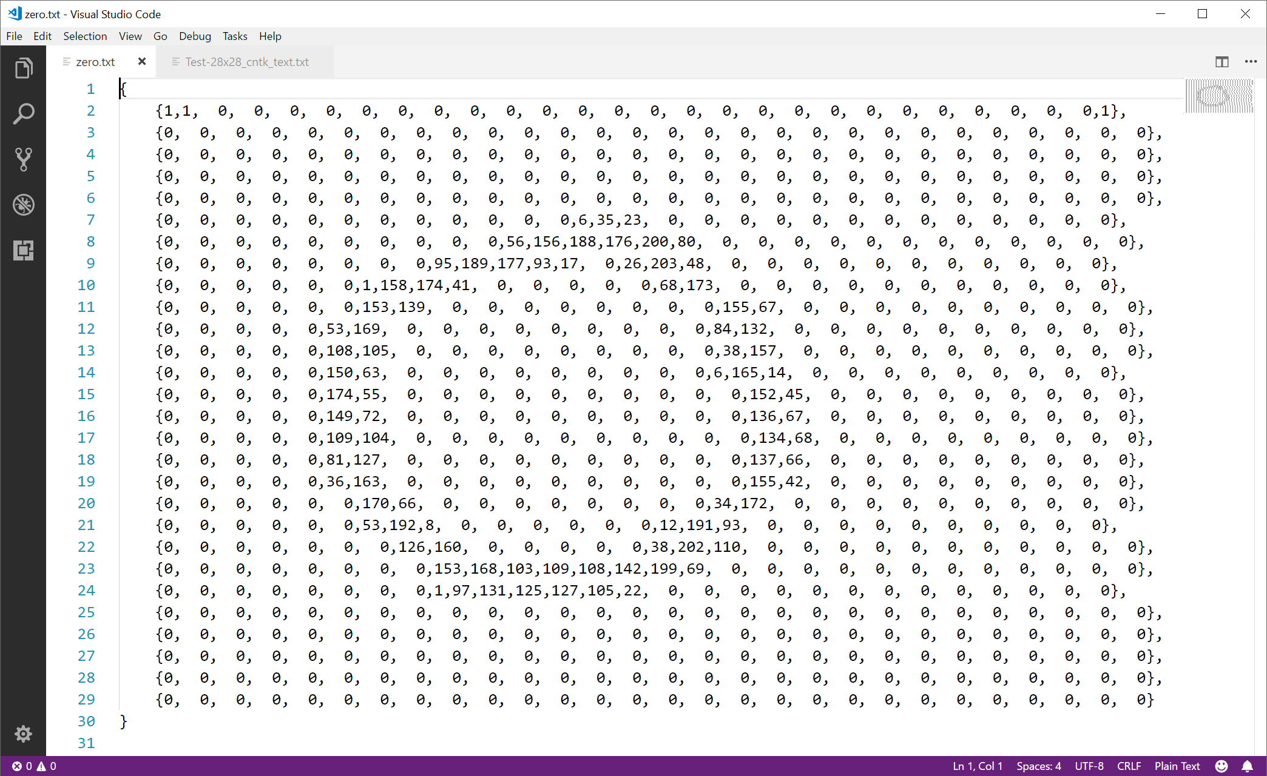

Slide 56
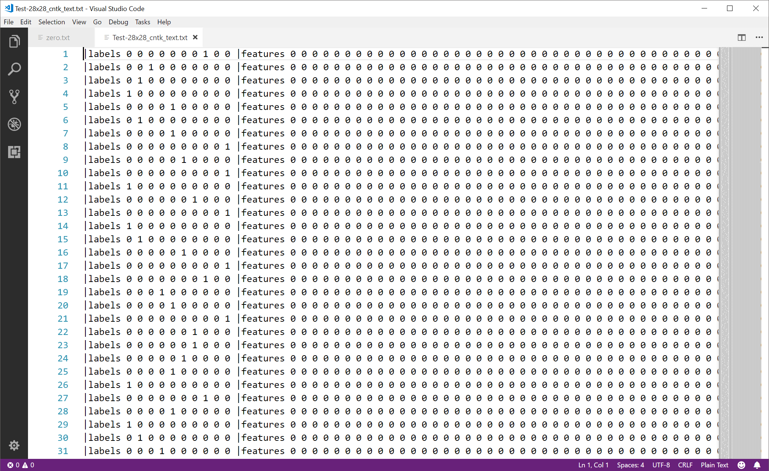

Slide 58
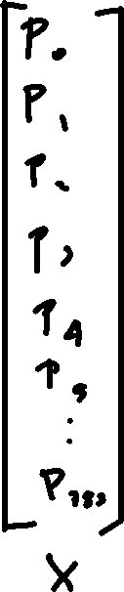
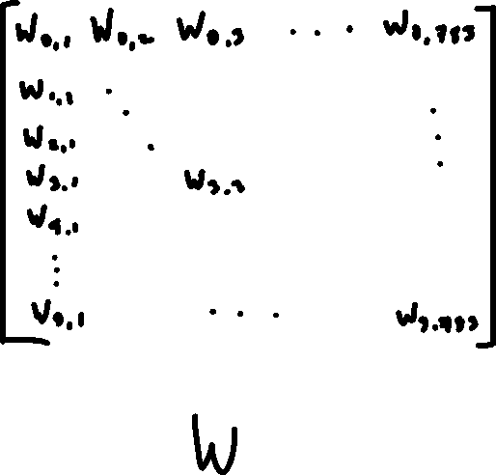
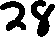


Slide 59


Slide 60
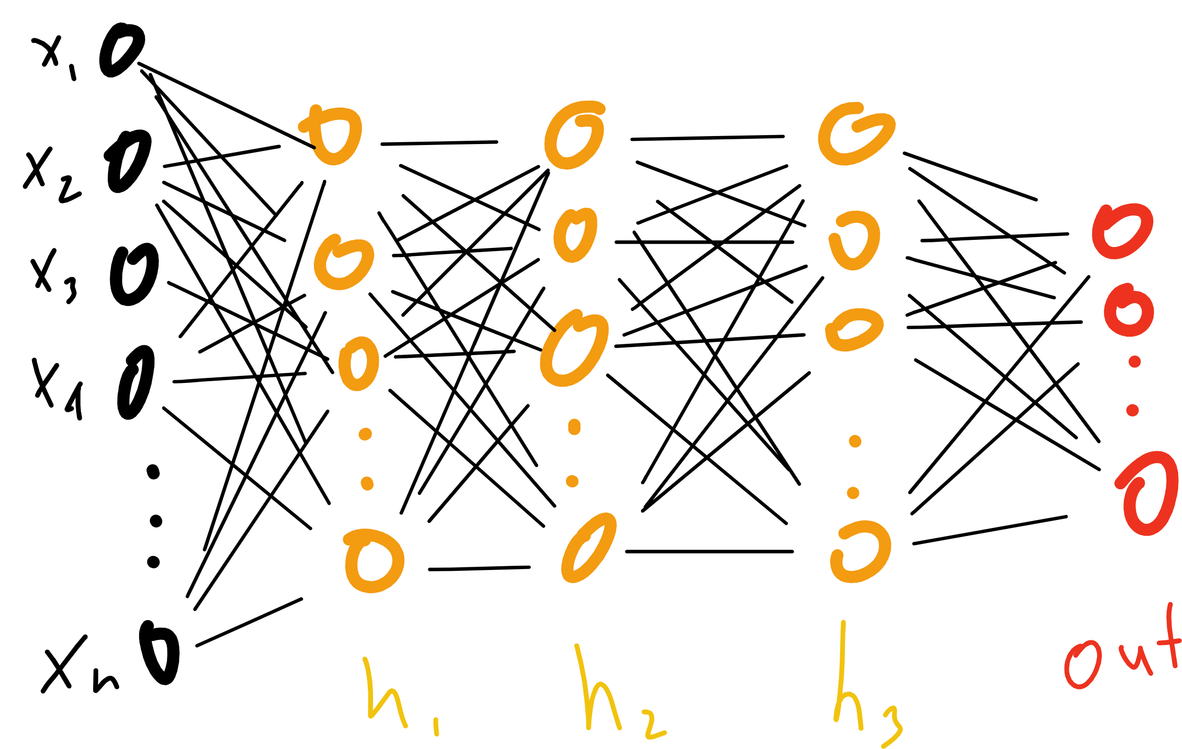

Slide 61
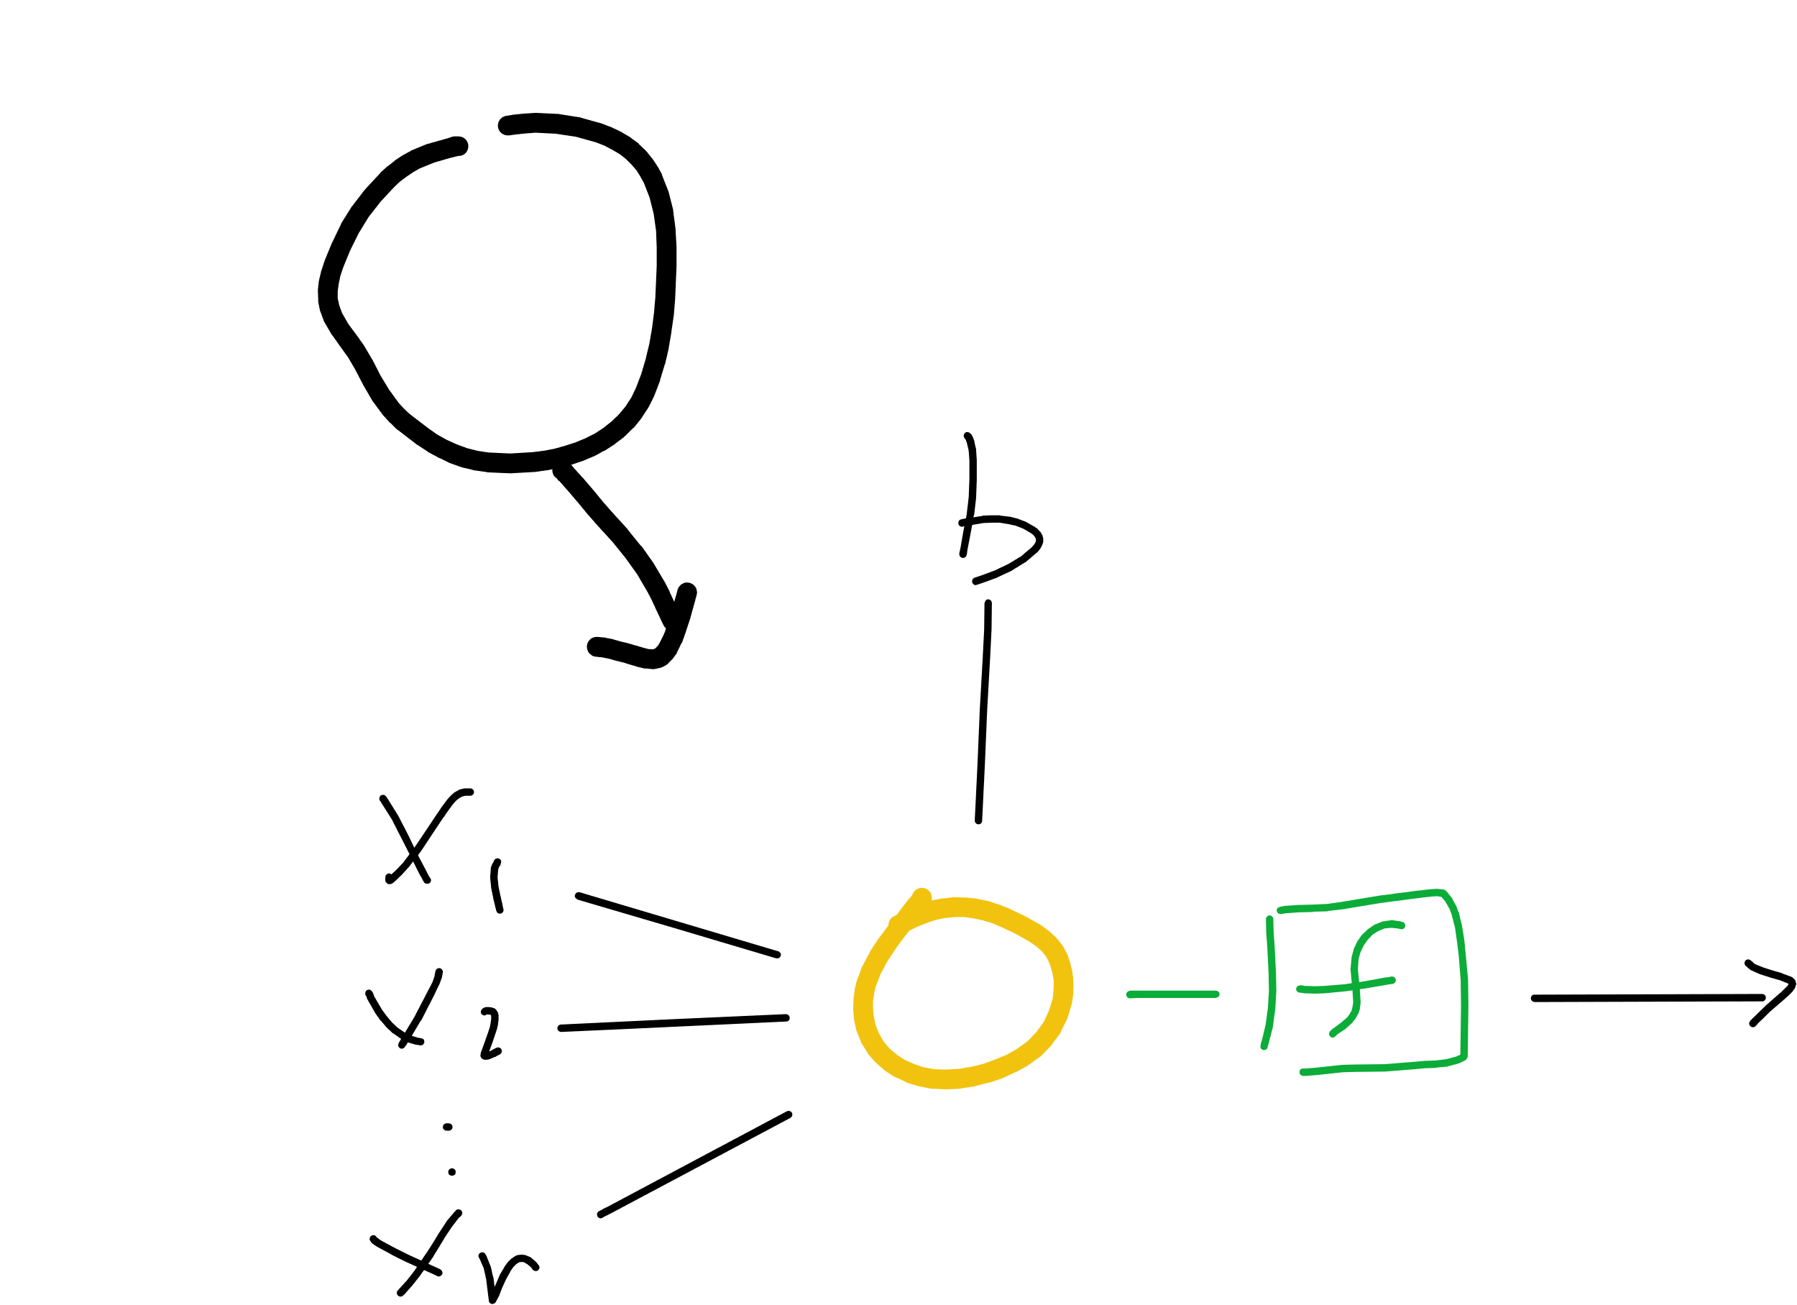
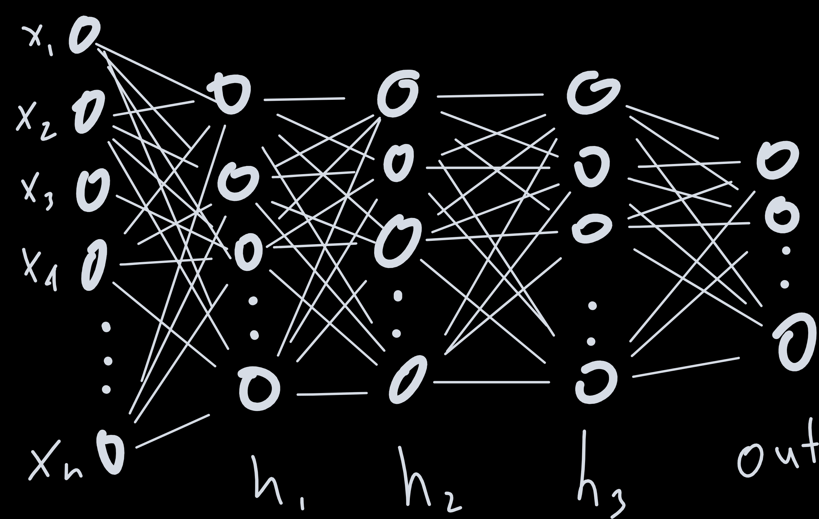
Notes:
Proof by induction

Slide 62
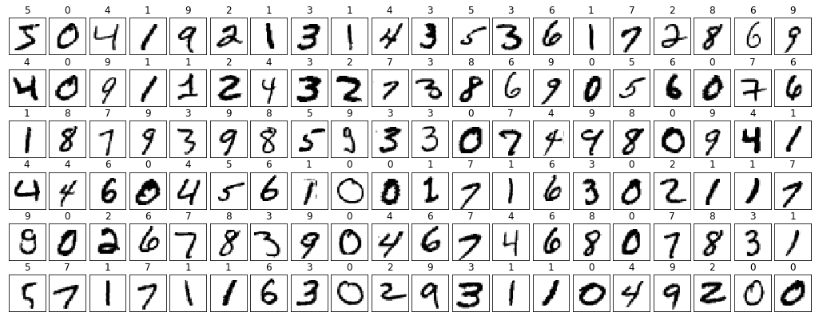
Notes:
Derivative?
Architecture

Slide 63
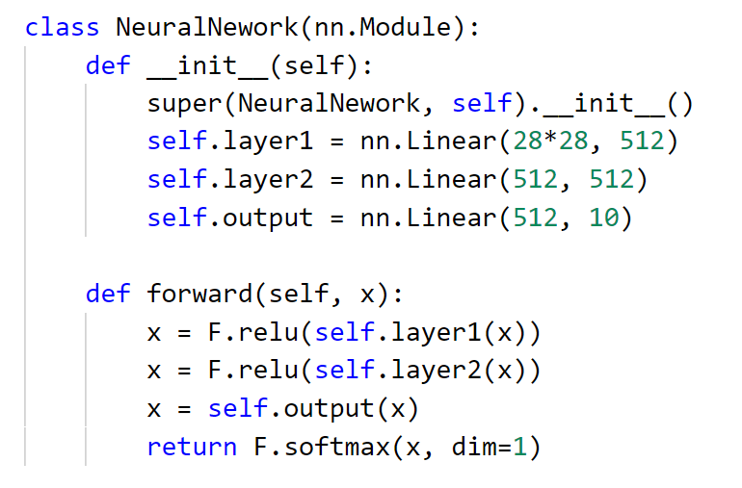

Slide 64
Better Network…

Slide 65
filters and pooling

Slide 66
filters
2 | 4 | 9 | 1
6 | 3 | 5 | 7
2 | 8 | 2 | 4
9 | 7 | 3 | 6
1 | 1 | 1
0 | 0 | 0
-1 | -1 | -1
3 | 0
-5 | -1

Slide 67
padding
0 | 0 | 0 | 0 | 0 | 0
0 | 2 | 4 | 9 | 1 | 0
0 | 6 | 3 | 5 | 7 | 0
0 | 2 | 8 | 2 | 4 | 0
0 | 9 | 7 | 3 | 6 | 0
0 | 0 | 0 | 0 | 0 | 0
-9 | -14 | -15 | -12
-4 | 3 | 0 | 7
-7 | -5 | -1 | 3
10 | 12 | 14 | 6
1 | 1 | 1
0 | 0 | 0
-1 | -1 | -1

Slide 68
pooling
-9 | -14 | -15 | -12
-4 | 3 | 0 | 7
-7 | -5 | -1 | 3
10 | 12 | 14 | 6
3 | 7
12 | 14

Slide 69
Notes:
Derivative?
Architecture

Slide 70
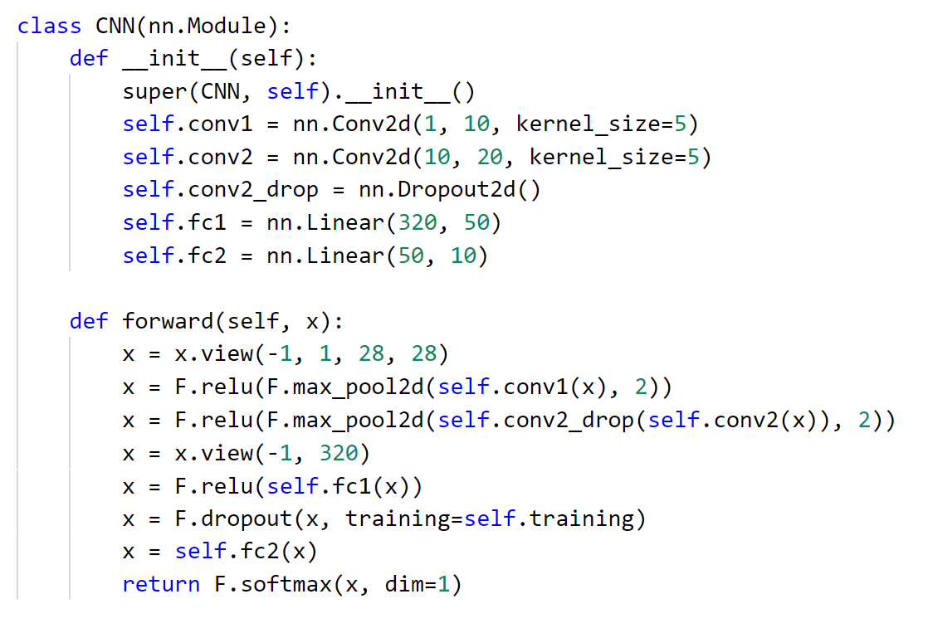

Slide 71
Putting it all together
a full run through to production

Slide 72
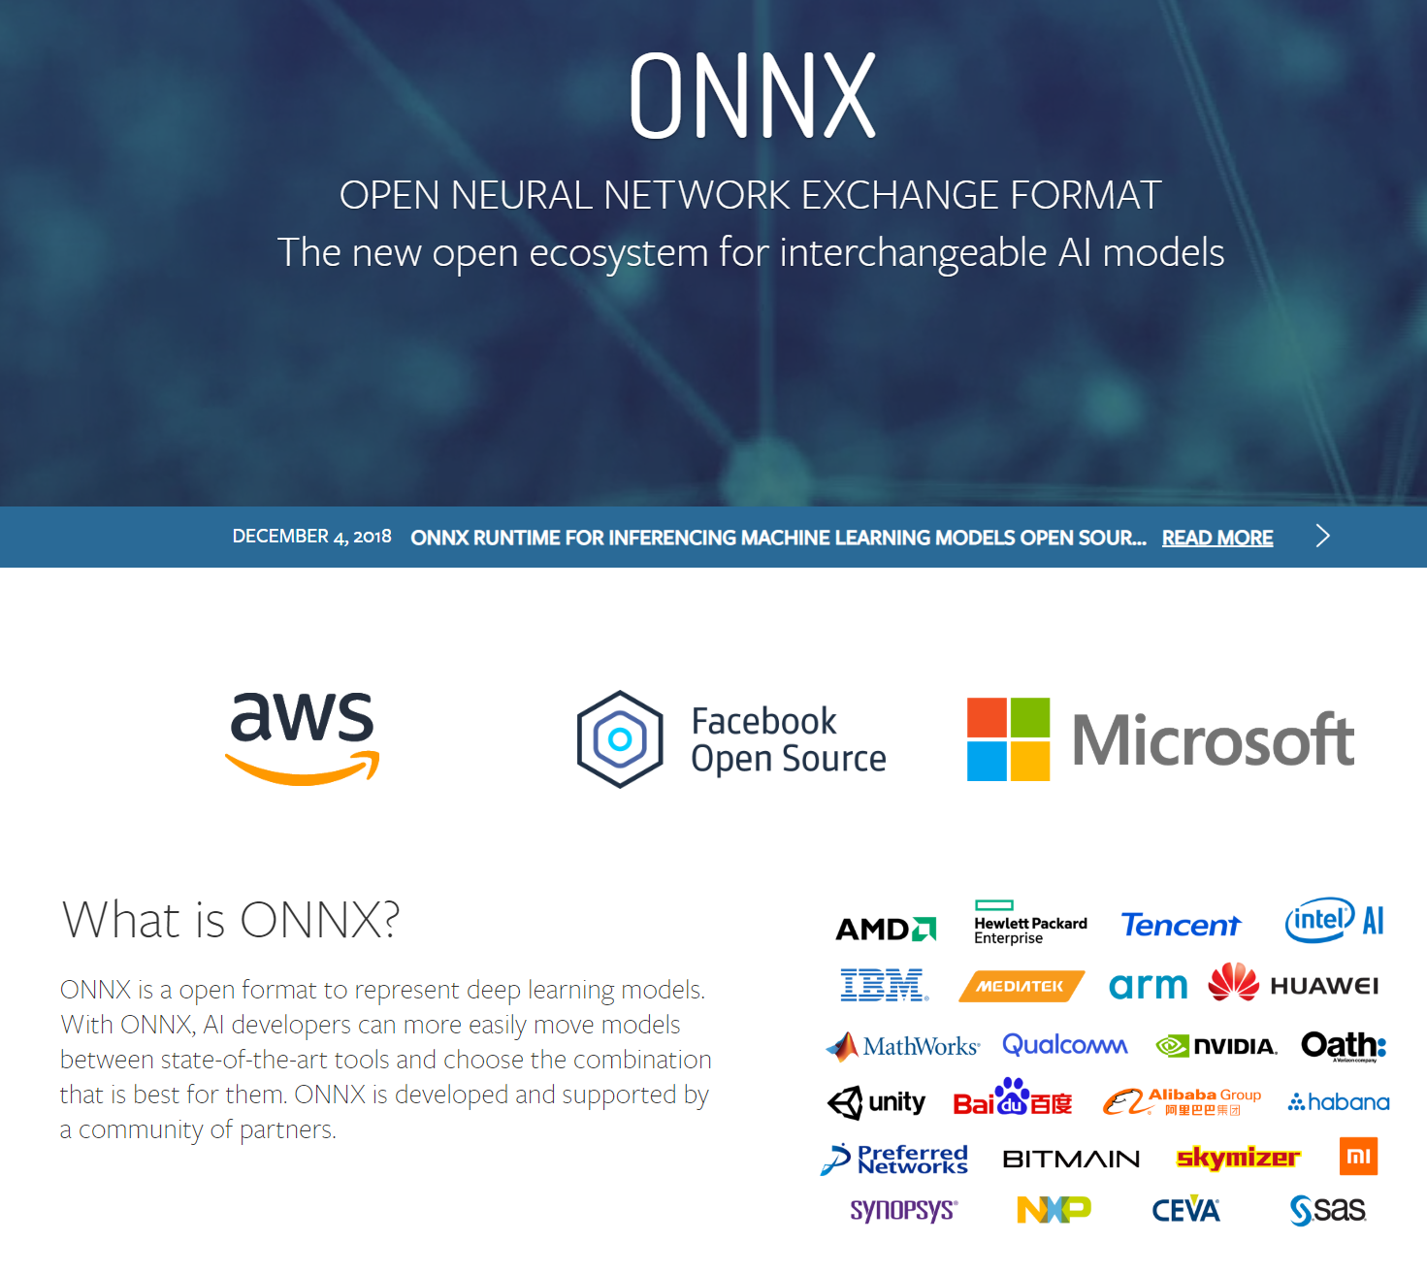

Slide 73
Handwriting Demo

Slide 74
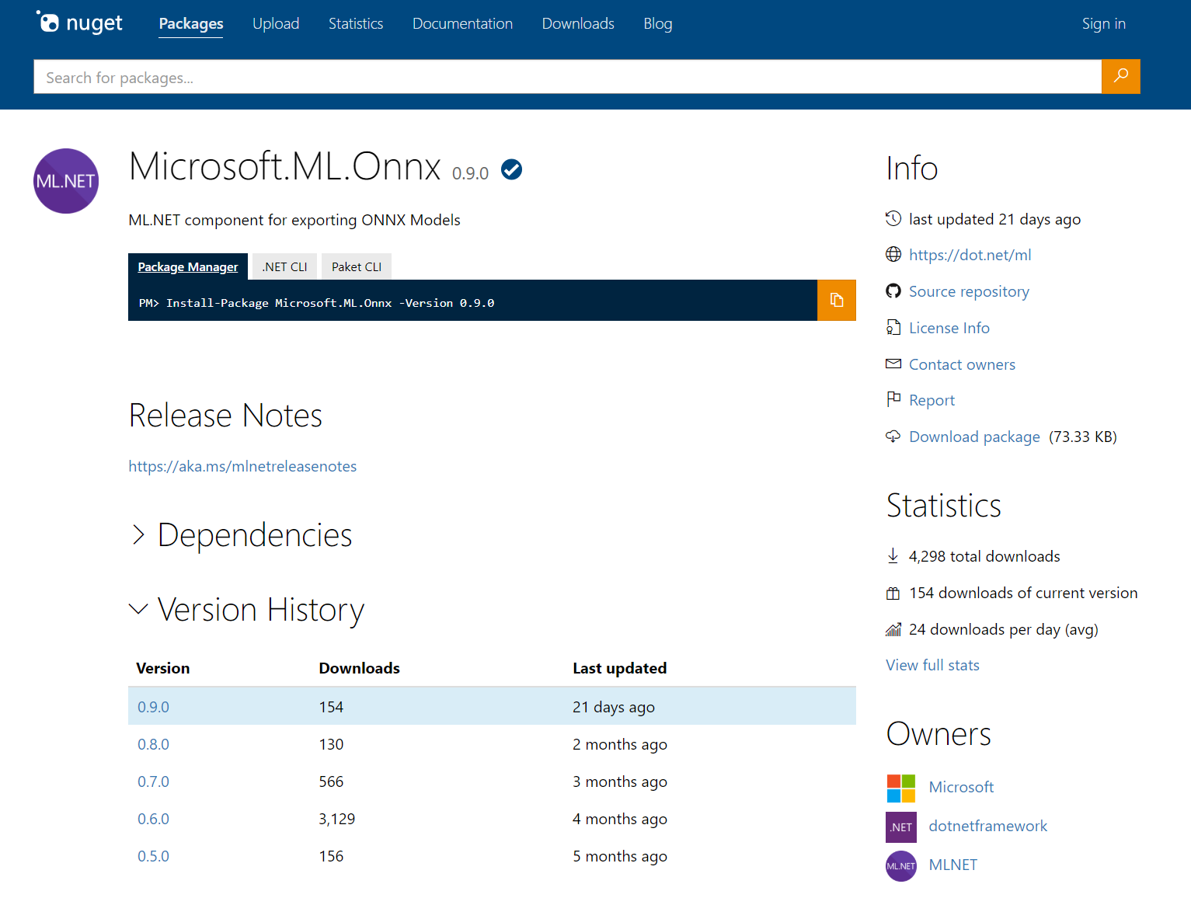

Slide 75






Azure Machine Learning service
Notes:
Experiments – this is where you try stuff / will have a history / track code through snapshots for every run / keep sanity (metadata)
Data Stores – where does your data live – MNIST is fine until it doesn’t fit on your hard drive, you also need to share with others, and you spilt your coffee once on your machine and lost everything
Compute – the metal where the experiments run (physical run on compute)
Models – output (just the good ones – you specify what to keep and how to version)
Images – package model with inference code and everything you need for it to run properly
Deployments – actual running models with ip addresses and everything

Slide 76
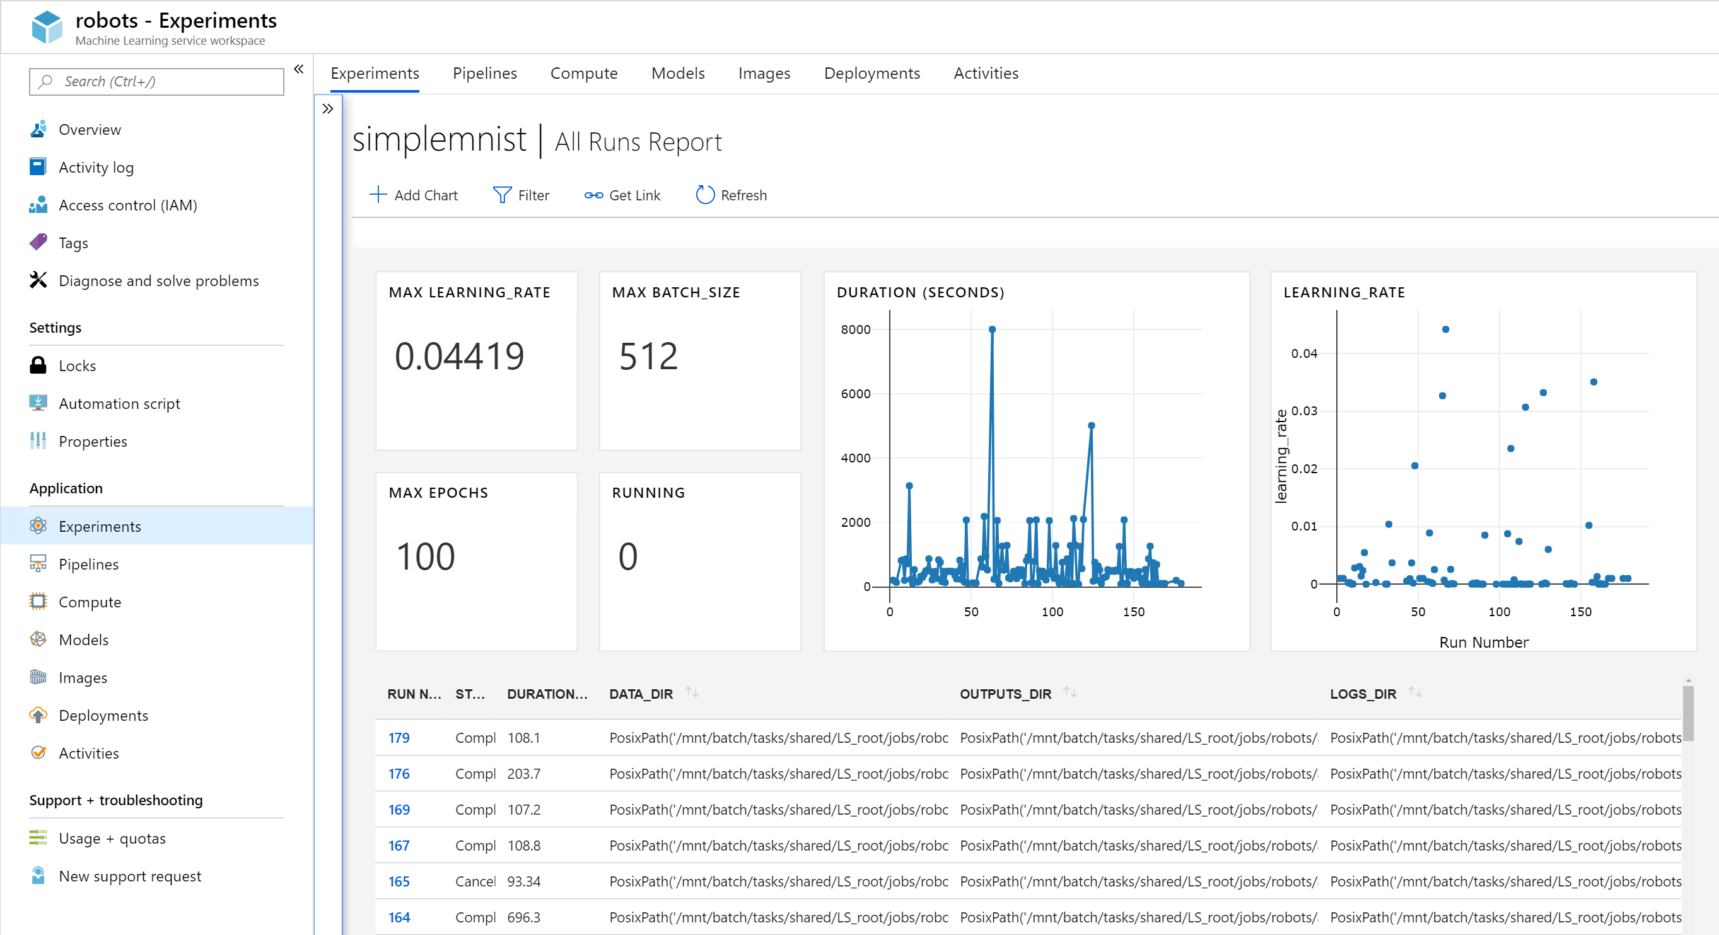

Slide 77
summary
Deep Learning Principles
input
model function
cost function
optimization method
PyTorch
Tensors, DataSets, DataLoaders
Models, Loss, Optimization
Inference
ONNX, Azure Machine Learning service

Slide 78
summary
Learn more about
Microsoft AI – https://aka.ms/aidevdocs
Cognitive Services – https://aka.ms/cogsvcs
Azure ML – https://aka.ms/azuremldocs
Deep Learning VMs – https://aka.ms/dlvmdocs
Code
https://github.com/sethjuarez/DeepLearningWithPyTorch
Get a hold of me!
seth.juarez@microsoft.com
@sethjuarez

Slide 79

Seth Juarez
Microsoft
@sethjuarez

